Slide 1










Whiteboardmaths.com
7
2
1
5
© 2004 All rights reserved

Slide 2

AREA
Remember: The perimeter of a shape is a measure of distance around the outside.
The area of a shape is a measure of the surface/space contained within its perimeter.
1 cm
1 cm
1 cm
1 cm²
Units of distance
mm
cm
m
km
inches
feet
yards
miles
Units of area
mm²
cm²
m²
km²
inches²
feet²
yards²
miles²
Area is measured in units²
Metric
Metric
Imperial
Imperial

Slide 3
AREA
Remember: The perimeter of a shape is a measure of distance around the outside.
The area of a shape is a measure of the surface/space contained within its perimeter.
1 cm
1 cm
1 cm
1 cm²
Units of distance
mm
cm
m
km
inches
feet
yards
miles
Units of area
mm²
cm²
m²
km²
inches²
feet²
yards²
miles²
Area is measured in units²
6 cm
Metric
Metric
18 cm²
3 cm
Imperial
Imperial
Area = 6 cm x 3 cm = 18 cm²

Slide 4


Area
4 m
To Find the area of a rectangle simply multiply the 2 dimensions together. Area = l x w (or w x l)
2 rows of 4 or 4 columns of 2
2 x 4 or 4 x 2
2 m
8 m²
8 m²
5 m
3 rows of 5 or 5 columns of 3
3 x 5 or 5 x 3
3 m
15 m²
4 rows of 7 or 7 columns of 4
4 x 7 or 7 x 4
15 m²
7 m
4 m
28 m²
28 m²

Slide 5
Area
Find the area of the following rectangles
2 cm
1
8 mm
3
Area = l x b
= 8 x 3
= 24 mm²
3 mm
20cm
5 m
2
4 m
Area = l x b
= 4 x 5 = 20 m²
Area = l x b
= 2 x 20 = 40 cm²
Not to scale

Slide 6
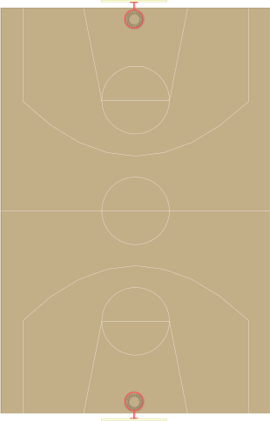
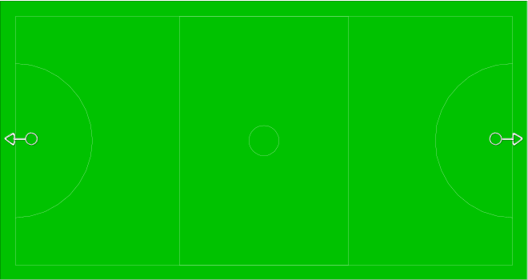
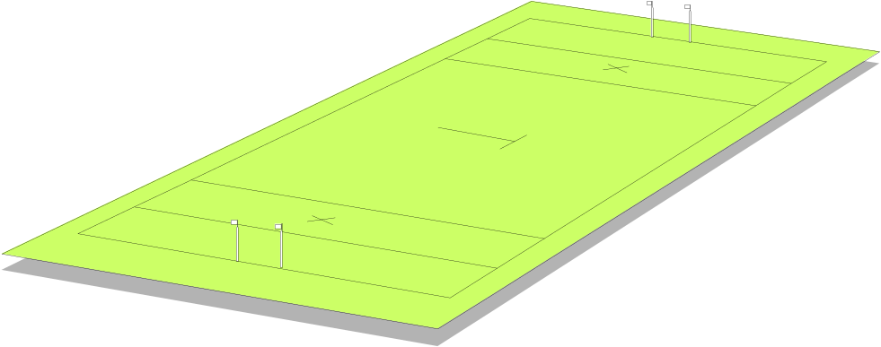

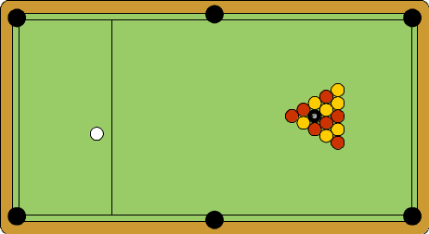
Find the area of each rectangular shape below.
1
100 m
2
50 m
90 feet
4500 ft²
5 000 m²
40 m
50 feet
3
120 m
4
8½ cm
18 900 cm²
5
4 800 m²
5½ cm
90 cm
46.75 cm²
Not to scale.
210 cm

Slide 7

Area of Compound Shapes
4m
Diagrams Not to scale
4m
16 m²
9 m²
3m
3m
Area = 4 x 4 + 3 x 3 = 16 + 9 = 25 m²

Slide 8
6 cm
6 cm
8 cm²
2 cm
12 cm²
2 cm
4 cm
4 cm
12 cm
8 cm
12 cm
16 cm²
8 cm
24 cm²
4 cm
2 cm
4 cm
8 cm²
2 cm
12 cm²
2 cm
2 cm
Area = 24 + 8 + 8 = 40 m²
Area = 16 + 12 + 12 = 40 m²

Slide 9
Area of Compound Shapes
8 m
Not to scale
2 m
16 m²
2 m
3 m
6 m²
?
5 m
20 m²
2 m
2 m
4 m
?
Area = 16 + 20 + 6 = 42 m²

